Slide 1


QUALITY IMPROVEMENT OF GOVERNMENT ACCOUNTABILITY AND PERFORMANCE REPORT Yanti C. SACAPRAWIRA, Setyo ANGGRAINI,
Memby U. PRATAMA
Goverment Employee of Ministry of Agrarian and Spatial Planning/National Land Agency Indonesia
FIG Congress 2015
From the Wisdom of the Ages to the Challenges of the Modern World
Sofia , 17– 21 Mei 2015

Slide 2

Point of Presentatios
Indonesia and Government System;
Performance Accountability and Government Accountability and Performance Report (LAKIP);
LAKIP of Ministry of Agrarian and Spatial Planning/National Land Agency and it’s value of assessment;
The Aspects that impact on assessment of LAKIP and it’s study;
Conclution and Recommendations.
FIG Congress 2015
From the Wisdom of the Ages to the Challenges of the Modern World
Sofia , 17– 21 Mei 2015

Slide 3
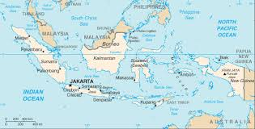
INDONESIA
FIG Congress 2015
From the Wisdom of the Ages to the Challenges of the Modern World
Sofia , 17– 21 Mei 2015

Slide 4
Introduction
Indonesia is an archipelago country has more than 17,508 islands, located between two (2) Continent, and between two (2) Ocean, with an area of 735,358 sq mi.
Indonesia is a unitary republic with a parliamentary system of government.
FIG Congress 2015
From the Wisdom of the Ages to the Challenges of the Modern World
Sofia , 17– 21 Mei 2015

Slide 5
Performance Accountability ?
Mission
Target
Goal
Obigation of Government Agencies
Success/ Failure
ACCOUNT
FIG Congress 2015
From the Wisdom of the Ages to the Challenges of the Modern World
Sofia , 17– 21 Mei 2015

Slide 6

Government Accountability and Performance Report (LAKIP)
LAKIP is annual performance reports containing of performance accountability in achieving the goals / targets strategic of the agency.
FIG Congress 2015
From the Wisdom of the Ages to the Challenges of the Modern World
Sofia , 17– 21 Mei 2015

Slide 7
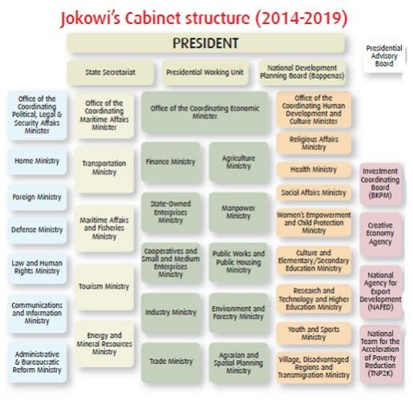
Structure Of Cabinet Ministry
FIG Congress 2015
From the Wisdom of the Ages to the Challenges of the Modern World
Sofia , 17– 21 Mei 2015

Slide 8

LAKIP value is still remain low
FIG Congress 2015
From the Wisdom of the Ages to the Challenges of the Modern World
Sofia , 17– 21 Mei 2015

Slide 9

LAKIP Assessment Results of Ministry of Agrarian and Spatial Planning/National Land Agency
Year | Values of LAKIP
2010 | C | C : Mediocre
2011 | C | CC: Fair
2012 | CC
2013 | CC
FIG Congress 2015
From the Wisdom of the Ages to the Challenges of the Modern World
Sofia , 17– 21 Mei 2015

Slide 10
Organitation Structure
Minister of Agrarian and Spatial Planning/National Land Agency
Deputy of Survey and Land Cadastre
Deputy of Control of Land And Community Empowerment
Deputy of Assessment and Handling of Disputes And Conflict Over Land
Deputy Of Land Rights And Land Registration
Deputy of Regulation and Arrangement of Land
Deputy of Survey and Land Cadastre
Deputy of Survey and Land Cadastre
Deputy of Survey and Land Cadastre
FIG Congress 2015
From the Wisdom of the Ages to the Challenges of the Modern World
Sofia , 17– 21 Mei 2015

Slide 11
LAKIP Assessment
Year | Latest Values of LAKIP
Deputy of Survey and Land Cadastre | A | A; Great
Deputy Of Land Rights And Land Registration | CC | B; Good
Deputy of Regulation and Arrangement of Land | A | CC; Fair
Deputy of Control of Land And Community Empowerment | CC
Deputy For Assessment And Handling of Disputes And Conflict Over Land | B
FIG Congress 2015
From the Wisdom of the Ages to the Challenges of the Modern World
Sofia , 17– 21 Mei 2015

Slide 12
Categories ratings for LAKIP:
No | Category | Range Value | interpretation
1 | AA | >85-100 | Excelent
2 | A | >75-85 | Great
3 | B | >65-75 | Good, it needs a little improvement
4 | CC | >50-65 | Fair, needs a lot of improvements that are not fundamental
5 | C | >30-50 | Mediocre, needs a lot of improvements, including a fundamental change
6 | D | 0-30 | Poor, it needs a lot of improvement and fundamental change
FIG Congress 2015
From the Wisdom of the Ages to the Challenges of the Modern World
Sofia , 17– 21 Mei 2015

Slide 13
there are some aspects that contribute to final score of LAKIP
a. Performance Planning (35%),
b. Performance Measurement (20%),
c. Performance Report (15%),
d. Performance Evaluation (10%),
e. Performance Achievement (20%),
FIG Congress 2015
From the Wisdom of the Ages to the Challenges of the Modern World
Sofia , 17– 21 Mei 2015

Slide 14
The Assessment of LAKIP of Ministry of Agrarian and Spatial Planning/ National Land Agency 2013
Aspects of Assessment | Percentage value (%) | Percentage value of assessment (%)
Performance Planning | 35 | 13.46
Performance Measurement | 20 | 17.06
Performance Report | 15 | 11.70
Performance Evaluation | 10 | 6.67
Performance Achievement | 20 | 15.16
 | 100 | 64.14
FIG Congress 2015
From the Wisdom of the Ages to the Challenges of the Modern World
Sofia , 17– 21 Mei 2015

Slide 15
Conclusion
LAKIP of the Ministry of Agrarian and Spatial Planning/National Land Agency needs a lot of improvements :
The strategic planning not oriented to the outcome;
There is not medium target yet;
There is several programme / activities that are innovative yet to be accommodated in the Strategic Plan.
FIG Congress 2015
From the Wisdom of the Ages to the Challenges of the Modern World
Sofia , 17– 21 Mei 2015

Slide 16

Strategy to Improvement LAKIP
Revising the Strategic Plan;.
Ensure that the goals and target of the programme/activities in accordance with the vision, and mission;
Determination of performance indicators of each programme/activities that support the goals and the target of the programme/ activities.
FIG Congress 2015
From the Wisdom of the Ages to the Challenges of the Modern World
Sofia , 17– 21 Mei 2015

Slide 17
THANKYOU
FIG Congress 2015
From the Wisdom of the Ages to the Challenges of the Modern World
Sofia , 17– 21 Mei 2015

