Slide 1

Sustainable Economic Growth through Development in Professional Services Sub-Sectors
YB. Dato’ Sri Mustapa Mohamed
Minister of International Trade and Industry, Malaysia
17th June 2014
Notes:
Slide 1
Thank the International Federation of Surveyors for the invitation to share some perspectives on relevant professional services in Malaysia
Malaysia is in the midst of implementing its National Transformation Policy that includes the Economic Transformation Program, so it is apt to highlight the role that professional services play.

Slide 2
Contents
Malaysia’s economic structure
MITI & agencies’ roles & overseas network
Malaysia’s New Economic Model
Promoting Sustainable Economic Growth
Strategic Reform Initiatives as Enablers
Professional Services in Malaysia
  Common characteristics
  Major industry trends
  Challenges and Way forward
Notes:
Slide 2
(In introducing the table of contents) Let’s look at the New Economic Model, and how it incorporates sustainability in economic growth
Introduce SRIs and discuss the growth of professional services sector in Malaysia

Slide 3
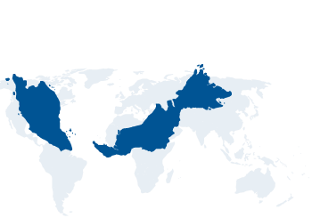
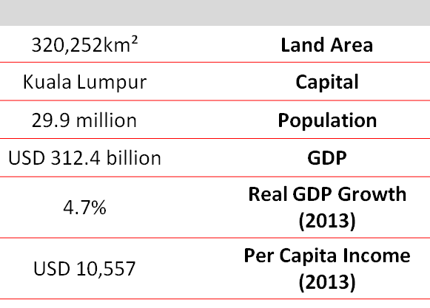
Malaysia’s Economic Structure
Indicator |  | 2013
GDP (%) |  | 4.7
 | Services | 5.9
 | Manufacturing | 3.4
 | Mining & Quarrying | 0.5
 | Agriculture | 2.1
 | Construction | 10.9
 |  | 2013
Inflation (%) |  | 2.1
Unemployment (%) |  | 3.0
External Trade (RM bil) |  | 2013
 | Exports | 719.8
 | Imports | 649.1
 | Total Trade | 1,368.9
 | Trade Balance | 70.7
Source: Department of Statistics
Notes:
Slide 2
(In introducing the table of contents) Let’s look at the New Economic Model, and how it incorporates sustainability in economic growth
Introduce SRIs and discuss the growth of professional services sector in Malaysia

Slide 4










MITI and agencies

Slide 5
Principal agency to oversee and drive investment into the manufacturing and services sectors in Malaysia.
Functions
to promote foreign and local investments in the manufacturing and services sectors;
to undertake planning for industrial development in Malaysia;
to recommend policies and strategies on industrial promotion and development to MITI; and
to evaluate applications for manufacturing licences and expatriate posts; tax incentives for manufacturing activities, tourism, R&D, training institutions and software development; and duty exemption on raw materials, components and machinery

Slide 6
Develop and promote Malaysia’s export to the world
Functions
To promote, assist and develop Malaysia’s external trade with emphasis on manufactured and semi-manufactured products;
To formulate and implement a national export marketing strategy;
To undertake commercial intelligence and market research and create a comprehensive database of information for the improvement and development of trade;
To organise training programmes to improve the international marketing skills of the Malaysian exporters; and
To enhance and protect Malaysia’s international trade interests abroad.

Slide 7
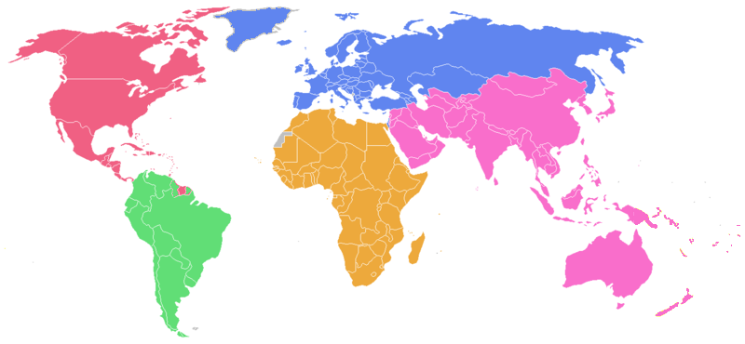
MITI and Agencies’ Offices Abroad
EUROPE
MIDA (6)
MATRADE (8)
MITI WASHINGTON D.C.
ASIA
MIDA (10)
MATRADE (19)
MITI
GENEVA
BRUSSELS
AMERICAS
MIDA (6)
MATRADE (7)
AFRICA
MIDA (1)
MATRADE (3)
MITI
BEIJING
NEW DELHI
SINGAPORE
JAKARTA
BANGKOK
AUSTRALIA
MIDA (1)
MATRADE (1)

Slide 8
At MITI, services sector involves …
Malaysia Services Development Council (MSDC)
RMK-11 (Technical Working Group on Professional Services)
Services Liberalisation (FTAs, RTAs, MRAs)
Service sector policy and development
Notes:
MITI’s role is development of the services sector.
Main roles in coordinating the Malaysia Services Development Council (MSDC)
Work towards preparing for the 11th Malaysia Plan (2016-2020) focusing on Professional Services.
Other policy and development work include liberalisation and policy development through FTAs, RTA and MRAs for market access for services sector as well as the autonomous liberalisation of the services sector.

Slide 9
The New Economic Model… powering growth through Sustainability and Inclusiveness
1Malaysia
High-income
Sustainability
Inclusiveness
(People First, Performance Now)
Government Transformation Program
Political Transformation Program
Economic Transformation Program
The New Economic Model (NEM) was announced by YB Prime Minister in March 2010
Notes:
Slide 3
The National Transformation Policy launched in 2009 is represented by the strategies established in the 10th Malaysia Plan that provide the basis for the 3 parallel transformation programs, towards a 1Malaysia aspiration of “People First, Performance Now”.
These building blocks provide the foundation of the New Economic Model – a model that promotes,
Pushing Malaysia into the high-income nation grouping with a target of USD15,000 GNI per capita by 2020
Meeting all present needs of the country without compromising future generations
Enabling all communities to benefit from the wealth of the country

Slide 10
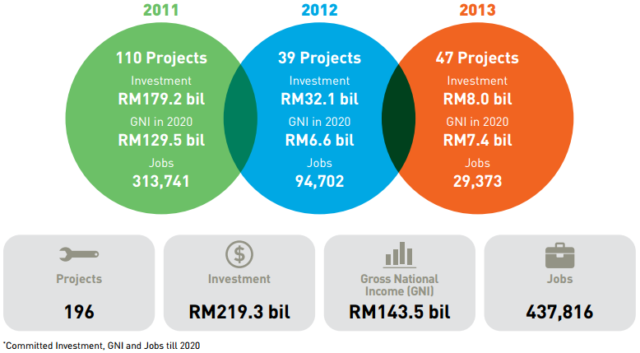
Sustainable Economic Growth… through Economic Transformation Program (ETP)
Goals of ETP
Raise GNI per capita US$15,000
Create 3.3 mil jobs
Secure US$444 bil investment
Notes:
Our target for GNI is based on the World Bank’s GNI per capita threshold for a high-income economy of US$12,276, and takes into account the organization’s historical global inflation benchmark figure of 2% until 2020
As at the end of 2013, a total of 196 projects have been created under ETP, that generated RM219 billion worth of committed investments. These are expected to contribute RM143 bil in GNI, and create more than 430,000 jobs

Slide 11
Strategic Reform Initiatives as Enablers… to ensure competitiveness
Human Capital Development
Competition, Standards & Liberalization
Liberalisation of sub-sectors – up to 100% foreign equity participation will be allowed
45 sub-sectors for liberalisation – among them; accounting / taxation, international schools, medical specialist, private university, telco NFP & NSP
Public Finance Reform
Narrowing Disparity
Reducing Government’s Role in Business
Public Service Delivery
6 Strategic Reform Initiatives (SRIs)
“Services sector remains an important engine to growth, therefore, has to be competitive and resilient..”
Source: ETP Annual Report 2013
Notes:
ETP was launched with 6 key “enablers”, dubbed the Strategic Reform Initiatives
One of the SRIs that directly supports sustainable economic growth is the SRI on “Competition, Standards & Liberalization”
Malaysia embarked on a second package of autonomous liberalization of its service sector involving 18 sub-sectors, of which 15 are now opened for greater foreign participation.
These measures are expected to enhance FDIs & promote a more conducive and competitive environment for the services sector

Slide 12
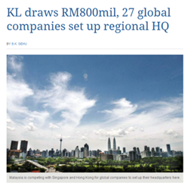
Success stories, testimonials and references …
KUALA LUMPUR AS REGIONAL HEADQUARTERS
27 global companies to set up regional headquarters in Kuala Lumpur (such as Schlumberger, Vale, IBM, Darden, Cargill, Naton, Colas Rail, Linde and Rentokil).
Total investment of RM800 mil.
Job creation of over 2,200 jobs over the past two years ( 80% Malaysian).
Expects to bring in investment to RM1bil and 500 jobs by middle of 2014.
xxxxx
Xxxxx
xxxxx
Source: InvestKL
Notes:
The success stories, testimonials and references from InvestKL contacts.
As the number of MNCs grows, the facilitation service required to ensure that these MNCs remains confident of their decision to set up their regional hub in Greater Kuala Lumpur become ever more critical.
InvestKL’s facilitation service focus on enhancing business efficiency, encouraging innovation activities (i.e. R&D, IP creation) and ensuring the MNCs find the right talent for their regional hub.

Slide 13
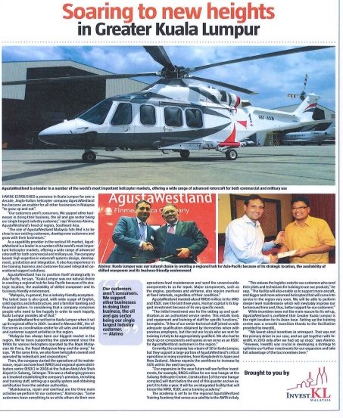
Success stories, testimonials and references …
AgustaWestland
- Set-up Regional Office in Malaysia in 2001 (regional hub for Asia Pacific region)
- Offers wide range of services for commercial and military rotocraft systems
- Invested RM50 mil. for operations in Maintenance, Repair & Overhaul (MRO) and Regional Spare Distribution Centre (RSDC)
Source: InvestKL
Notes:
The National Transformation Policy launched in 2009 is represented by the strategies established in the 10th Malaysia Plan that provide the basis for the 3 parallel transformation programs, towards a 1Malaysia aspiration if “People First, Performance Now”.
These building blocks provide the foundation of the New Economic Model – a model that promotes,
Pushing Malaysia into the high-income nation grouping with a target of USD15,000 GNI per capita by 2020
Meeting all present needs of the country without compromising future generations
Enabling all communities to benefit from the wealth of the country

Slide 14
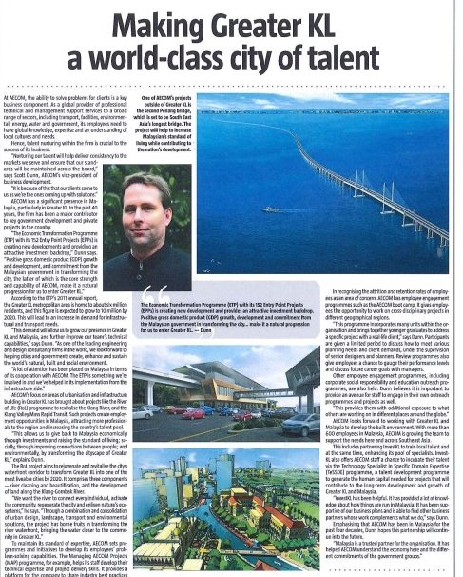
Success stories, testimonials and references …
EACOM
- Global provider for professional technical and management support services (transport, facilities, environmental, energy etc)
- A major contributor to key in government projects in Malaysia since 40 years ago :
* Second Penang Bridge
* Klang Valley Mass Rapid Transit
* Rivitalising Klang River under the River of Life Project)
Source: InvestKL
Notes:
The National Transformation Policy launched in 2009 is represented by the strategies established in the 10th Malaysia Plan that provide the basis for the 3 parallel transformation programs, towards a 1Malaysia aspiration if “People First, Performance Now”.
These building blocks provide the foundation of the New Economic Model – a model that promotes,
Pushing Malaysia into the high-income nation grouping with a target of USD15,000 GNI per capita by 2020
Meeting all present needs of the country without compromising future generations
Enabling all communities to benefit from the wealth of the country

Slide 15
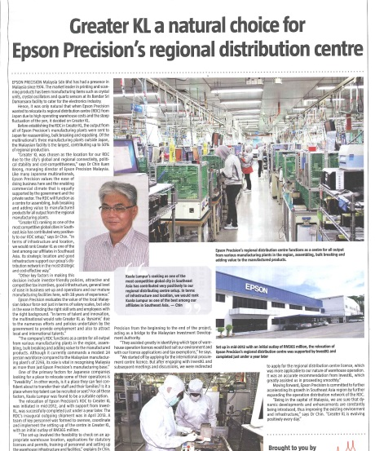
Success stories, testimonials and references …
EPSON PRECISION
Establish since 1974
Regional Distribution Centre (RDC) relocation into Kuala Lumpur in mid 2012, initial outlay RM365 mil
RDC function as a centre for all outputs from various manufacturing plants in the region, assembling, bulk breaking and adding value to manufactured products
Source: InvestKL
Notes:
The success stories, testimonials and references from InvestKL contacts.
As the number of MNCs grows, the facilitation service required to ensure that these MNCs remains confident of their decision to set up their regional hub in Greater Kuala Lumpur become ever more critical.
InvestKL’s facilitation service focus on enhancing business efficiency, encouraging innovation activities (i.e. R&D, IP creation) and ensuring the MNCs find the right talent for their regional hub.

Slide 16
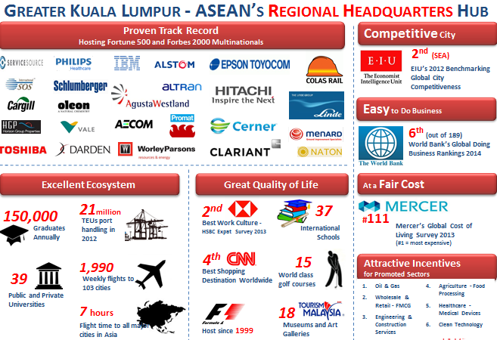
Success stories from InvestKL
Source: InvestKL
Notes:
Summary of InvestKL work in Greater Kuala Lumpur

Slide 17
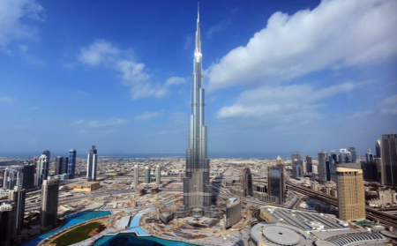
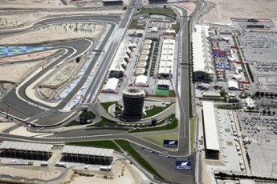
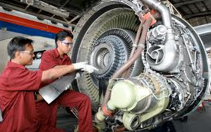
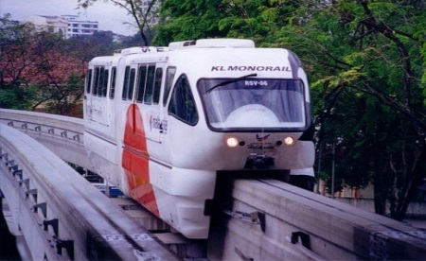
Malaysian professionals …
State-of-the-art engineering mastery that has capped the Burj Khalifah (the world’s tallest building)
Designed and built some of the iconic buildings in the world, from airports to universities and townships
A regional aviation maintenance repair and overhaul (MRO) services hub
Developed the Monorail in Mumbai and Sao Paolo.
A regional transport and rail MRO services hub.
17
Notes:
Malaysian professional services, particularly in the engineering and related sector, have ventured internationally and participated in various projects across the globe.
Some Malaysian engineering companies that have ventured abroad:
LFE Corporation Berhad: China, Vietnam, Philippines, Qatar, UAE
Toprank Corporation: Vietnam

Slide 18
Construction Projects in Middle East & India
Region | Total Projects | Project Value (USD Million)
Middle East | 146 | 12,201.38
South Asia | 134 | 6,195.05
ASEAN | 250 | 4,055.65
Africa | 42 | 3,624.16
Others | 119 | 3,745.01
Total | 691 | 29,821.25
* Between 1986 – 31 Dec 2012
Source: CIDB
18

Slide 19
The Professional Services include …
Legal
Surveying
Management Consultancy
Accounting & taxation
Engineering & engineering related
Architecture
Urban planning & landscape
Notes:
These are some of the more established and prominent professional services in Malaysia

Slide 20
Professional Services… support business and trade in other sectors
Total output of Professional Services (2010) : RM4.92 billion
Source: DOSM, 2010
Notes:
Professional services in Malaysia have always played an intermediary role within various sectors.
These include wholesale & retail, education, insurance & banks, and communications.
In 2010 alone, professional services generated a total output of close to RM5 billion.

Slide 21
Professional Services .. share common characteristics
Industry Structure
Dominated by small firms/SMEs
(legal & accounting : 99%, engineering & QS : 98%, architecture : 93%, management consultancy : 94%)
Exports
Minimal; largely from the few big firms
Technology & Standards
Adopt and use up-to-date basic software
Openness
Market access:
- autonomous liberalisation
- commitments under FTAs
- ASEAN MRAs
Compliant to international standards
Professional services account for relatively small share of Malaysia’s services exports
Notes:
(Describe common characteristics as depicted in each quadrant)

Slide 22
Professional Services… major global industry trends
Multi Disciplinary Practices
Out Sourcing / Offshoring
Mergers & Acquisition / Joint Venture
Adoption of International Best Practices
Notes:
Major industry trends in professional services
Multi-disciplinary practices – address global demand for integrated solution, especially true for construction-related services (such as engineering).
Outsourcing/Off-shoring - Developed countries remain responsible for three quarters of service exports, but there is a growing trend towards the outsourcing of services, such as call-centres and software development, to developing countries.
M&A and JV – examples in 2013 alone,
Accenture acquired Procurian Inc (procurement business process solutions company);
BDO merged with PKF (UK)
Accountancy and business advisory firm, BDO LLP, has today announced that its merger with PKF (UK) LLP has completed. From today, the firm will operate as one, under the BDO brand and as part of BDO’s international network, the largest global accountancy organisation aimed at the mid-market, with revenues of over $6bn operating in 138 countries worldwide.
The merged firm is a leading accountancy and business advisory firm generating revenues approaching £400million. It boasts a transformed regional network, employing 3,500 people across 24 UK locations

Slide 23
Challenges for the services sector ....
Liberalisation
Domestic Regulations
Co-ordination
Transparency of rules & regulations
Reliable information/ data
Change In Mind-set
Notes:
(Describe the challenges in development and coordination of the services sector in Malaysia)
Particularly for services liberalisation, some of the issues and challenges on include:
Industries are not prepared to make higher commitments.
Most stakeholders in the services sectors are not fully aware of the impact of services liberalisation.
Acts and Regulations governing business and professionals services require review.
Ministries/Agencies/State authority to identify domestic regulations that inhibit potential foreign investments and business opportunities.
Need for greater co-ordination in the development of this sector, especially in enhancing capacity for export and take advantage of opportunities overseas.
Need to review existing rules and regulation to be consistent with Malaysia’s commitments under WTO, AFAS and FTAs
Mechanism to enhance data collection. (GDP contribution, trade, investments, services index etc)
Mind-set change required in the public sector to look at the services sector as a business.

Slide 24
Way forward for Malaysia ….
Focus on knowledge-intensive, high technology
Focus on niche area (e.g. professional services, creative industry and oil and gas)
As a regional hub for niche area in professional engineering services
Streamline governance and accelerate regulatory reform
Export ready services sub-sector for international market
Notes:
(Describe way-forward in each column)

Slide 25
END OF PRESENTATION

